Slide 1
The Network Layer(OSI model)
MBABAZI GRACE - S26B38/035
ABALO LUCY - S26B38/071
NABIRYE VIOLA - S26B23/081
EDWARD EDWIN SSEMBOGGA- S26B23/087
ASIIMWE ATUHUMUZA OLUSEGUN- S26B23/153
MUWAYA JOSHUA A.S - S26B23/011
KUTESAKWE TIMOTHY - S26B23/143
OPIO JONATHAN - S26B23/085
MARK BEST OCHAGA - S26B23/083

Slide 2
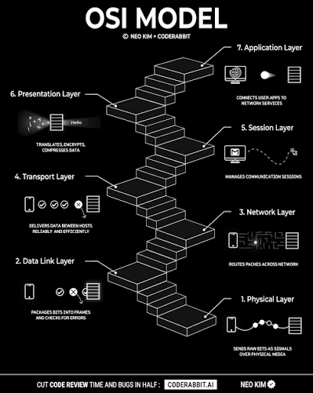
The OSI Model
The OSI (Open Systems Interconnection) Model is a conceptual framework created by the International Organization for Standardization (ISO) to describe how data is transmitted across a network using a structured seven-layer architecture.

Slide 3
Layers of the OSI Model.
The OSI model is split into seven
distinct layers which are;
The Physical layer
The Data link layer
The network layer
The transport layer
The Session layer
The Presentation Layer
The Application Layer

Slide 4
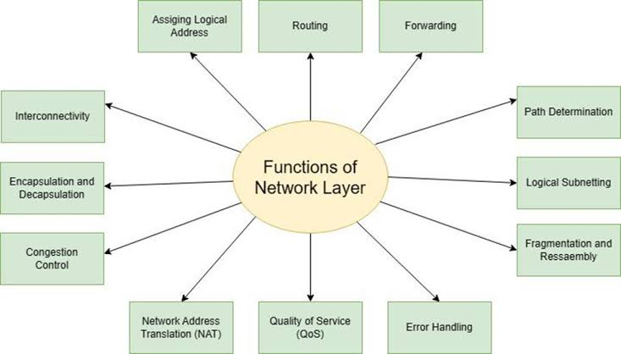
The Network Layer(3rd layer)
The Network layer manages data transmission between hosts across different networks by handling logical addressing and path finding.
It provides a logical end to end logical system so that data can be routed across several layer 2 networks.

Slide 5
Key functions of the 3rd layer
Logical addressing-assigns logical addresses (ip addresses) which are used to identify networks and hosts.
Routing-Determines the best path for data packets to travel from the source network to the destination network.
Forwarding-Directs packets to the correct next hop based on their destination ip address.
Encapsulation-Wraps layer 3 packets with a header containing source and destination ip addresses creating an envelope around the data.
Internetworking-connects different types of networks to allow communication between them.

Slide 6
How it works.
The 3rd layer first identifies devices with an IP address whereby the IP address consists of 2 things;the network a device is on and the specific device id.
As data is passing through the 3rd layer from the 2nd layer, the 3rd layer adds a header to the data containing source and destination Ips and therefore turning the data into a packet.
The packet then is routed across different routers whereby each router reads the header and forwards the packet to the most optimal router to use to get the packet to its destination.This is a process of continuous hops from one router to another.

Slide 7
